Slide 1
Terrain GENERATION
João Braga, Rafael Correia, Robert Szabo

Slide 2
TABLE OF CONTENTS
01
Biome GENERATION
02
TERRAIn GENERATION
03
FEATURES
04
Future development & Comparisons

Slide 3
01
Biome GENERATION

Slide 4
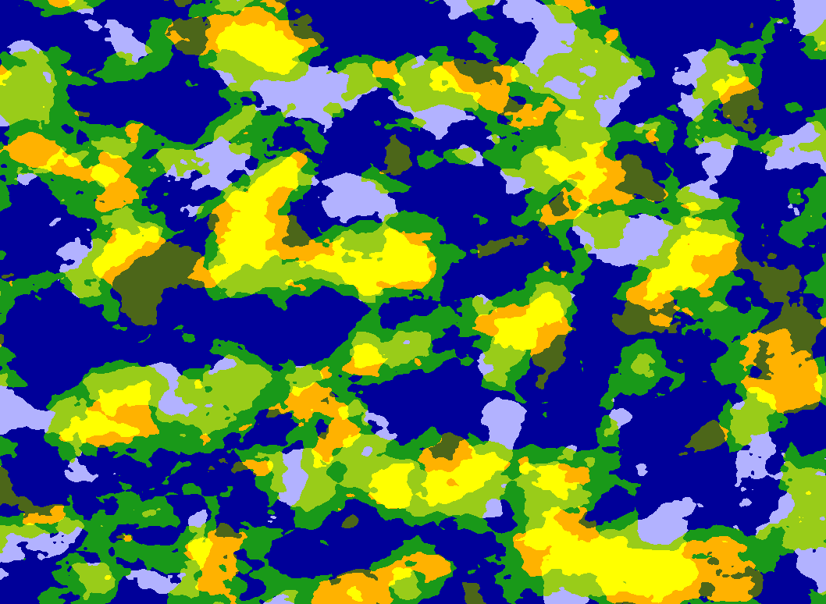
Scale Temperature num Octaves Temperature limits Precipitation Num Octaves Precipitation noise frequency precipitation limits Precipitation offsets

Slide 5
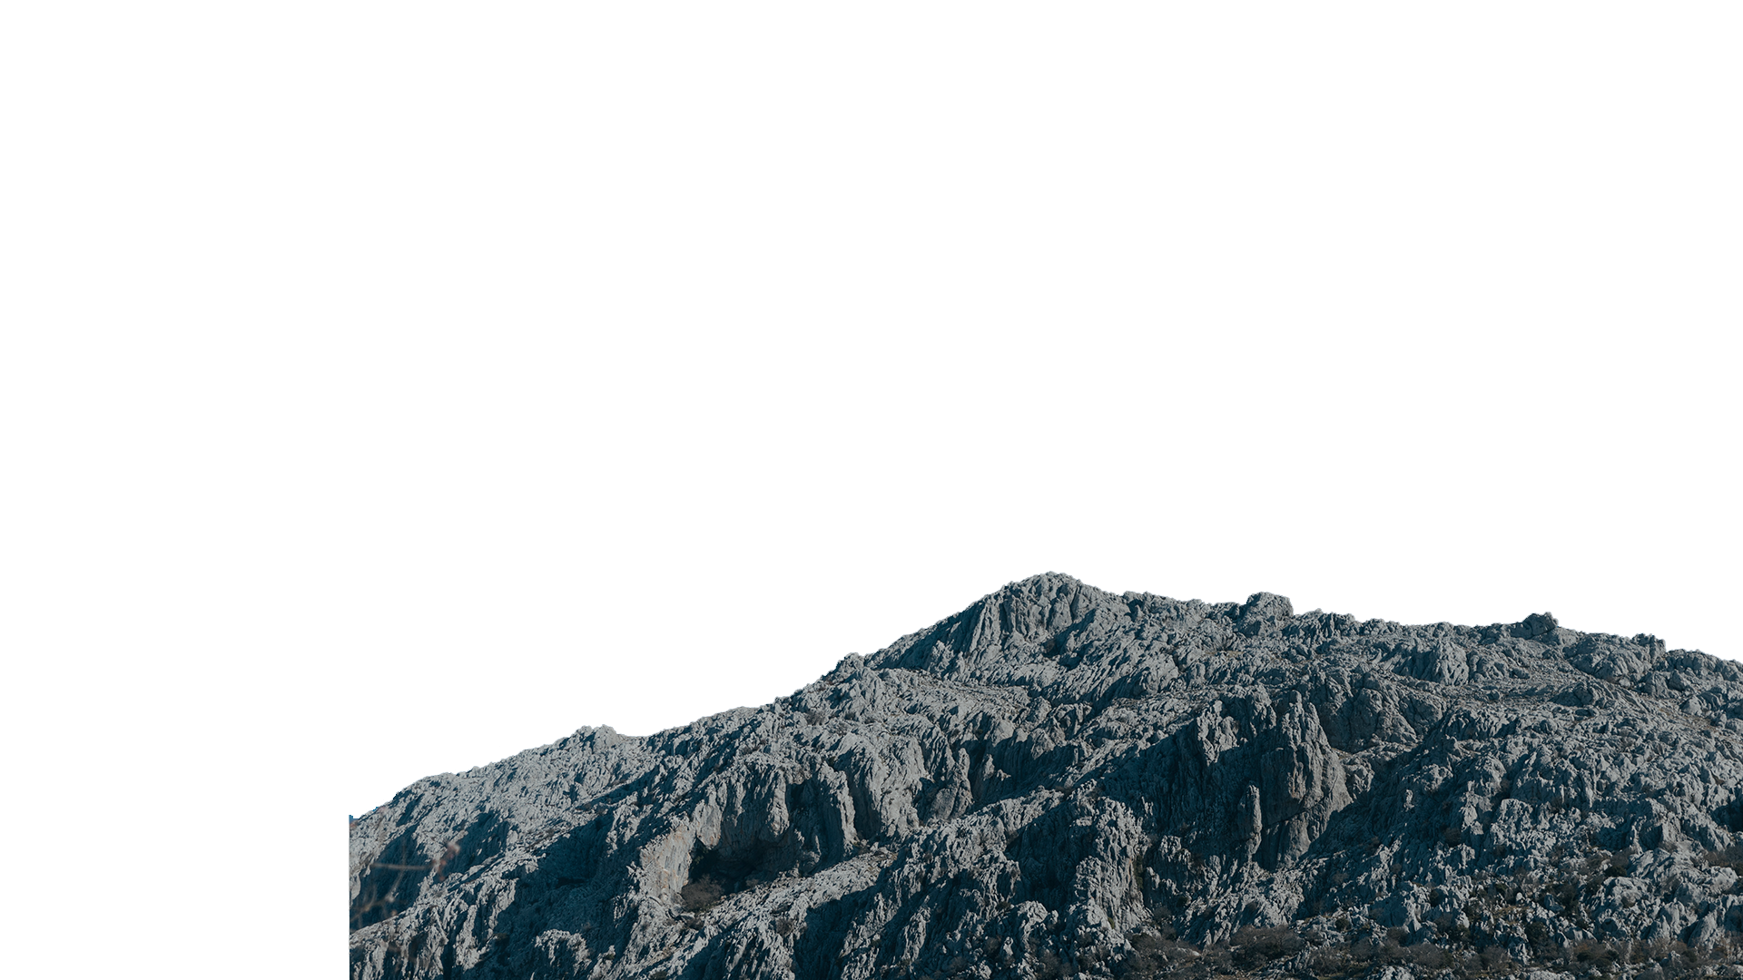

BIOMAS

Slide 6
02
TERRAIn GENERATION

Slide 7
Amplitude Frequency base height
NUM OCTAVES SCALE PERSISTENCE LACUNARITY Height MULTIPLIER

Slide 8
03
FEATURES

Slide 9
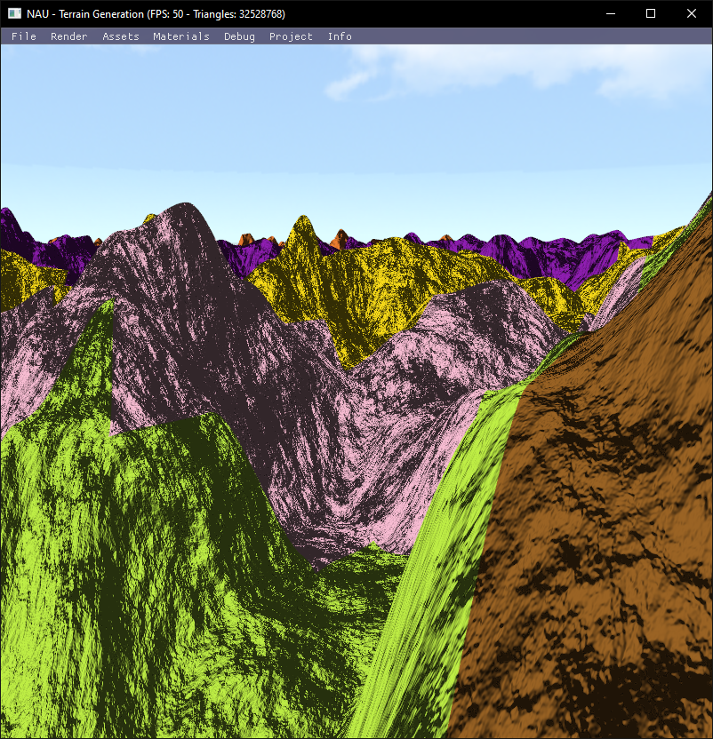
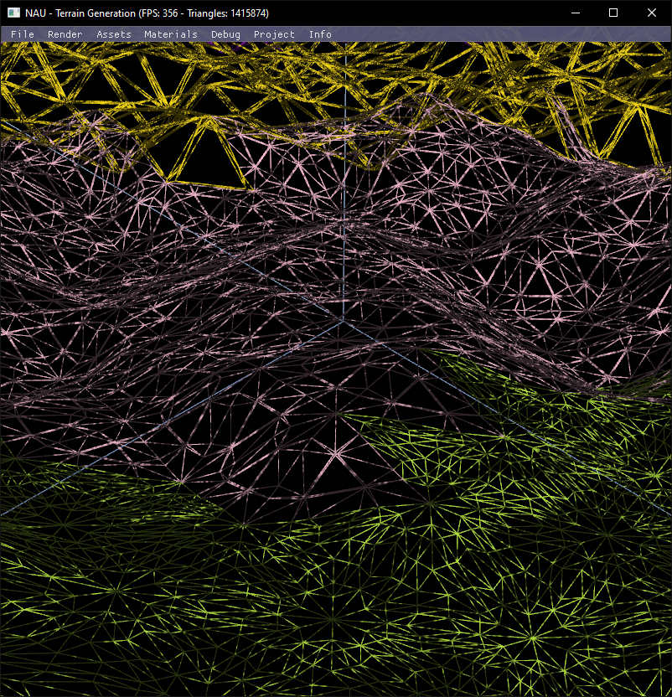
TESSELAÇÃO

Slide 10
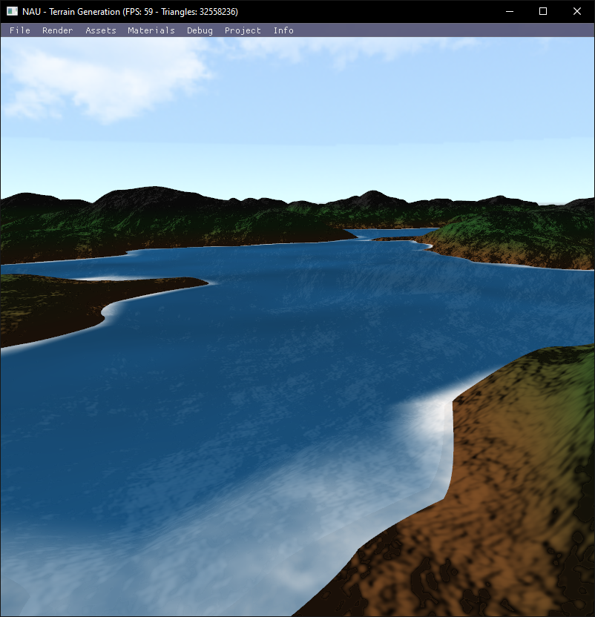
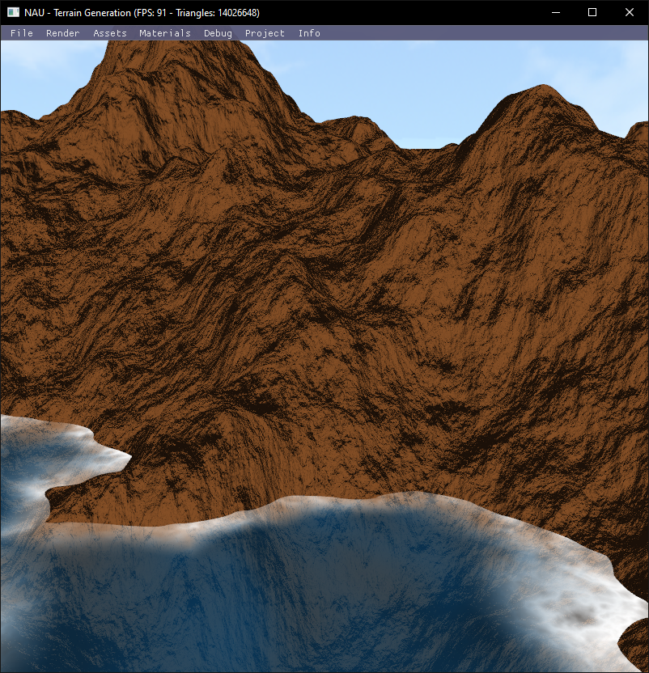
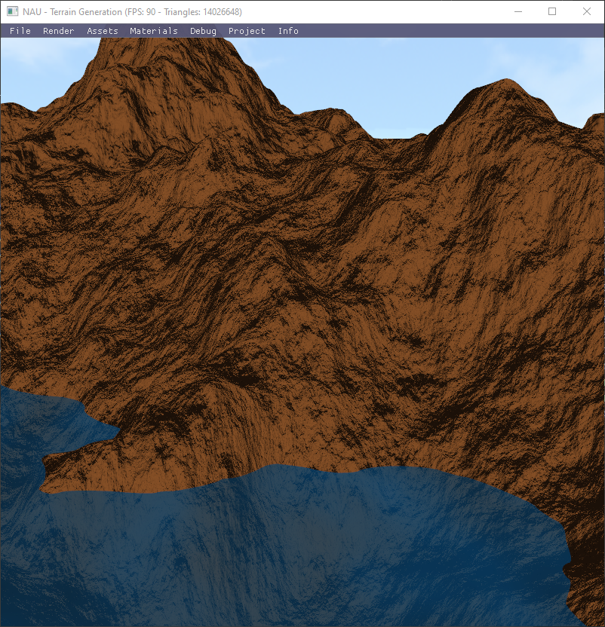
ÁGUA

Slide 11
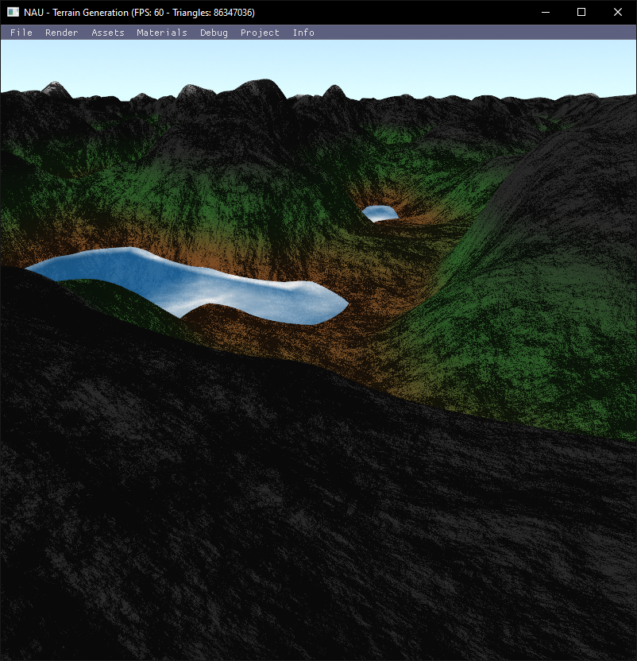
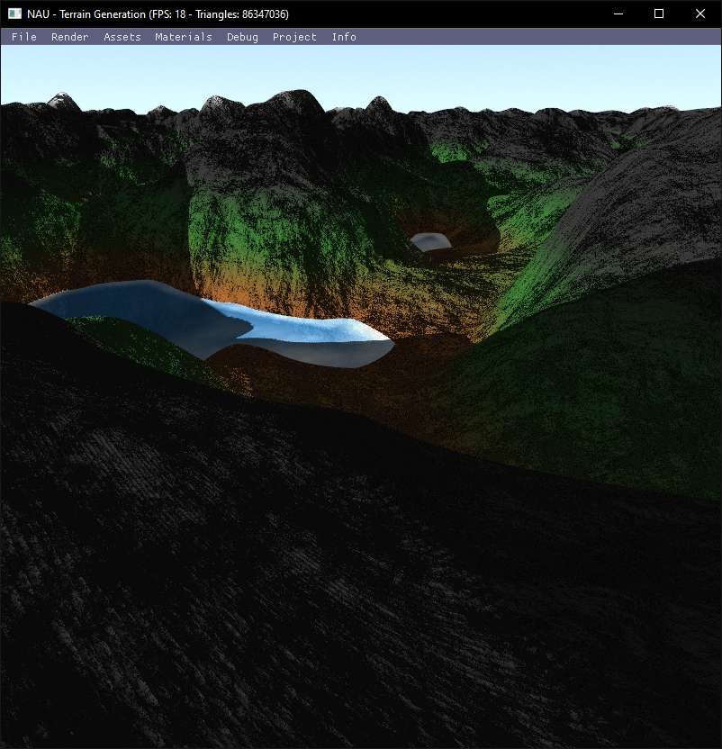
ShADOW Mapping

Slide 12
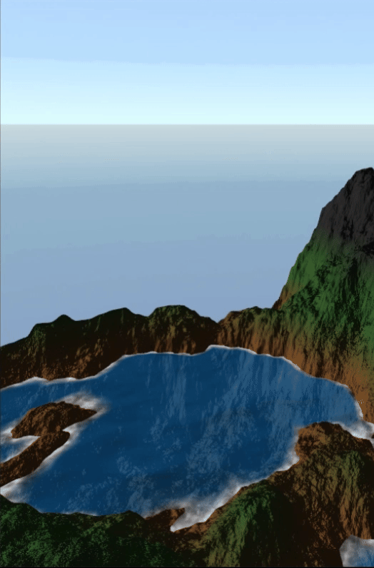
TERRENO INFINITO

Slide 13


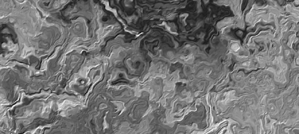
DOMAIN WARPING
fbm(p)
fbm(p + fbm(p))
fbm(p + fbm(p +fbm(p)))

Slide 14
“Thats’ all Folks !”
Made by:
João Braga PG54194
Rafael Correia PG54162
Robert Szabo PG53951

